Slide 1
SOFTWARE QUALITY ASSURANCE BUG REPORTING PROCESS WITH JIRA
A final project present by (Yaroslav, Saad, Nishat, Mannpreet, Martins)

Slide 2
For creation of a bug report, the tester shall follow these steps:

Slide 3
For creation of a bug report, the tester shall follow these steps:
1. ACCESS THE ALLOCATED PROJECT IN THE JIRA
- Open your preferred web browser and navigate to the JIRA website.
- Log in to your JIRA account using your credentials.
- Once logged in, you'll be directed to the dashboard.
- Locate the project you've been allocated to by either browsing through the list of projects or using the search functionality.
- Click on the allocated project to enter its workspace.

Slide 4
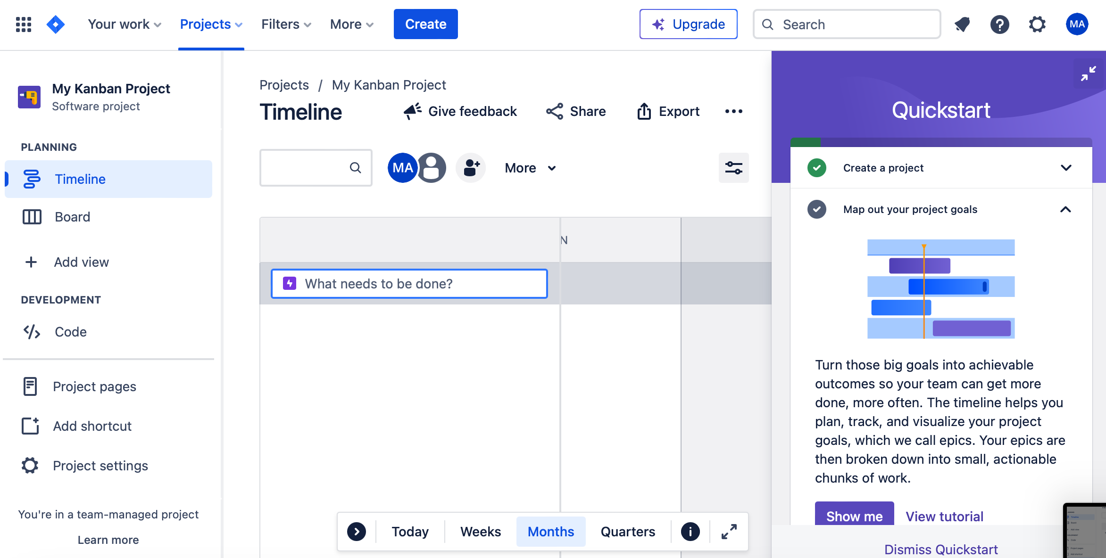
JIRA LOGIN DASHBOARD

Slide 5
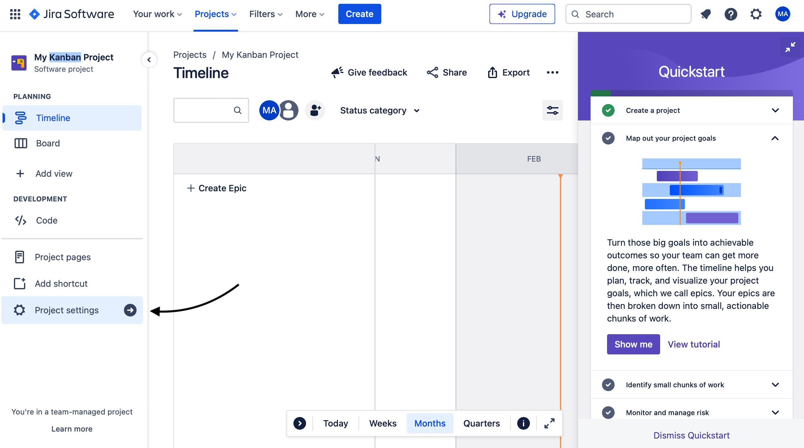
FIND THE BUG REPORT TEMPLATE CREATED BY YOUR LEAD TESTER

Slide 6
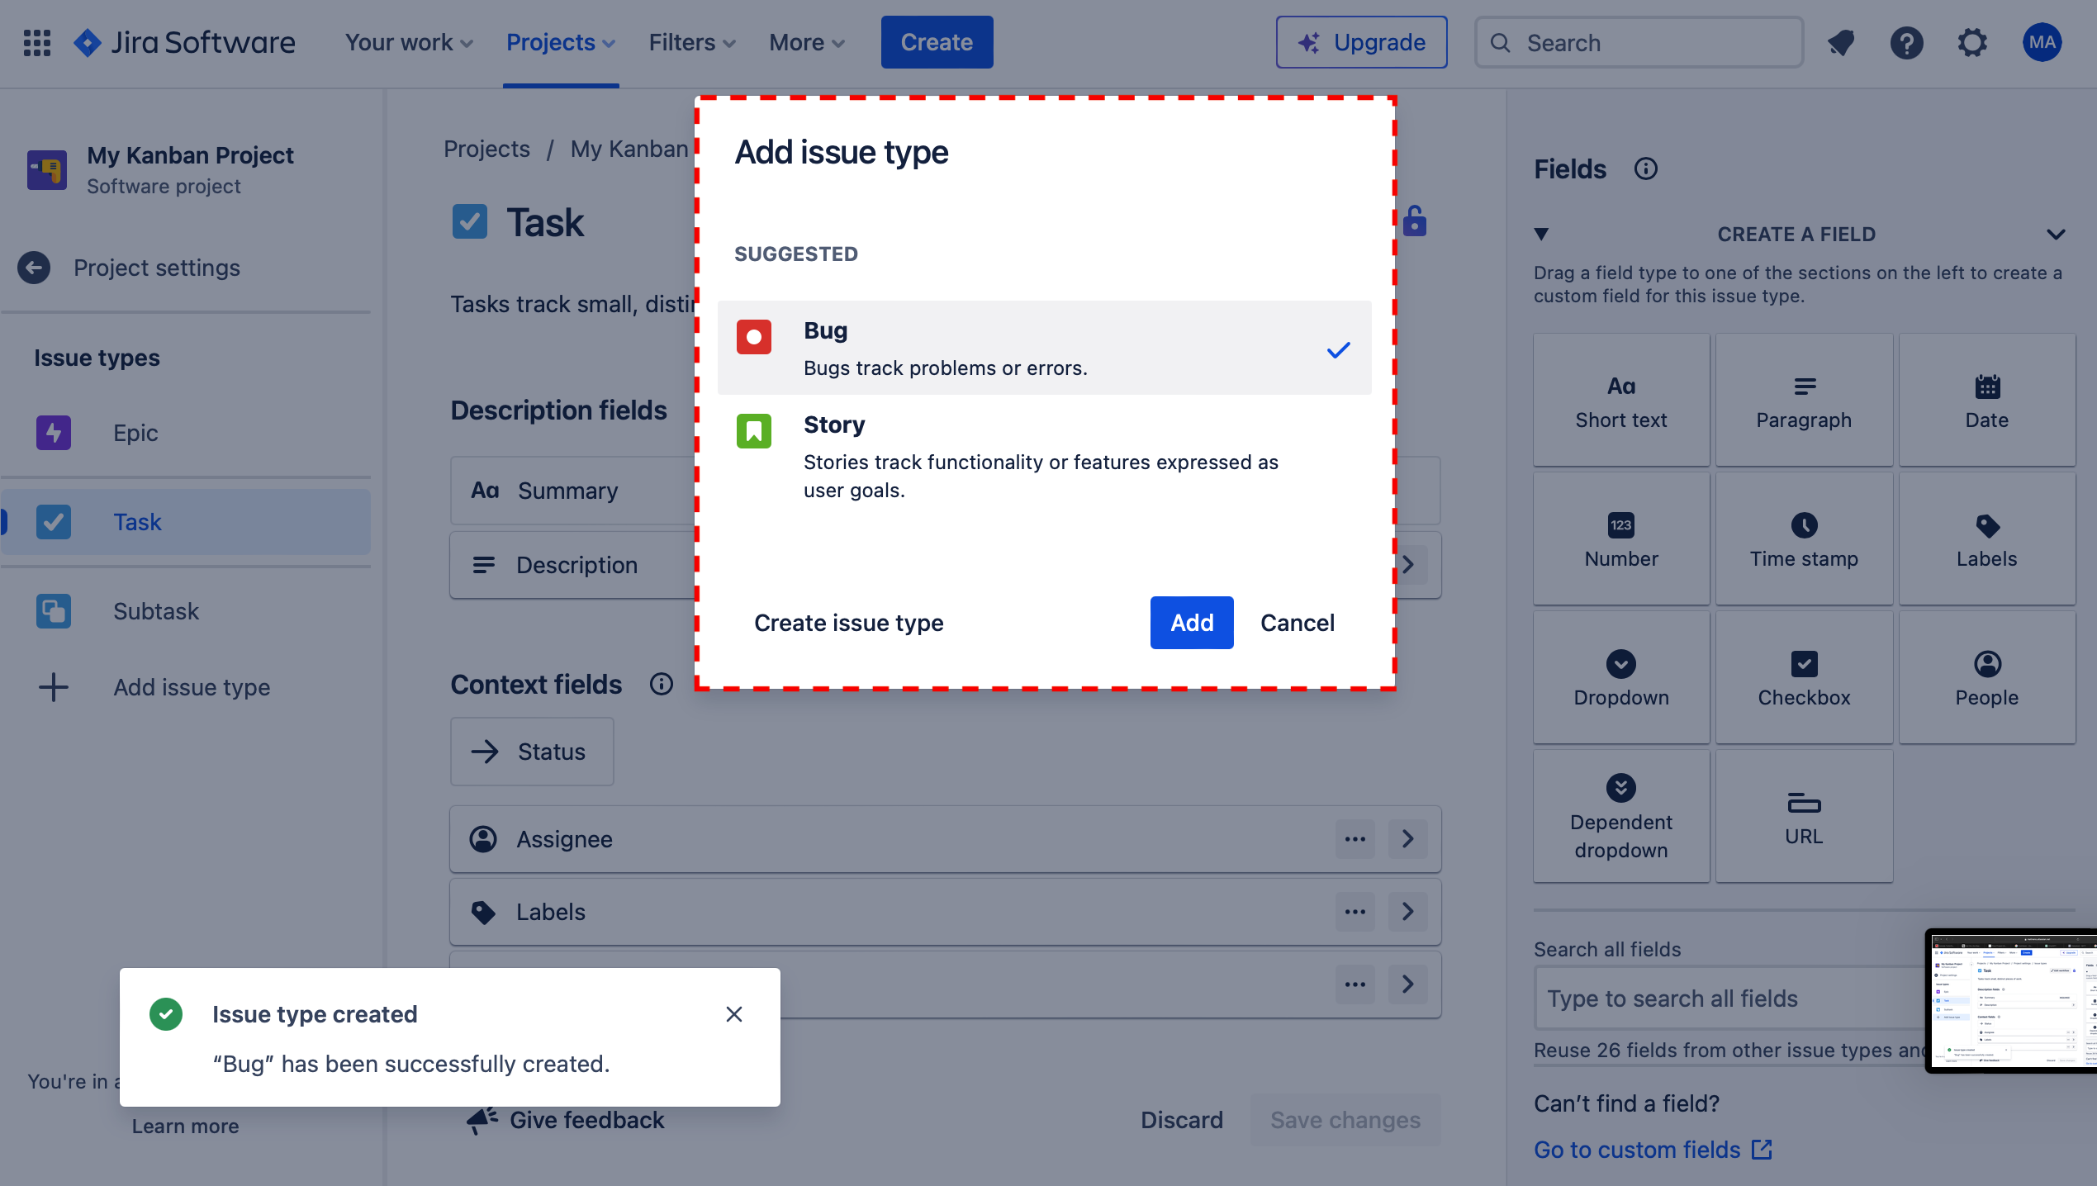
FIND THE BUG REPORT TEMPLATE CREATED BY YOUR LEAD TESTER

Slide 7
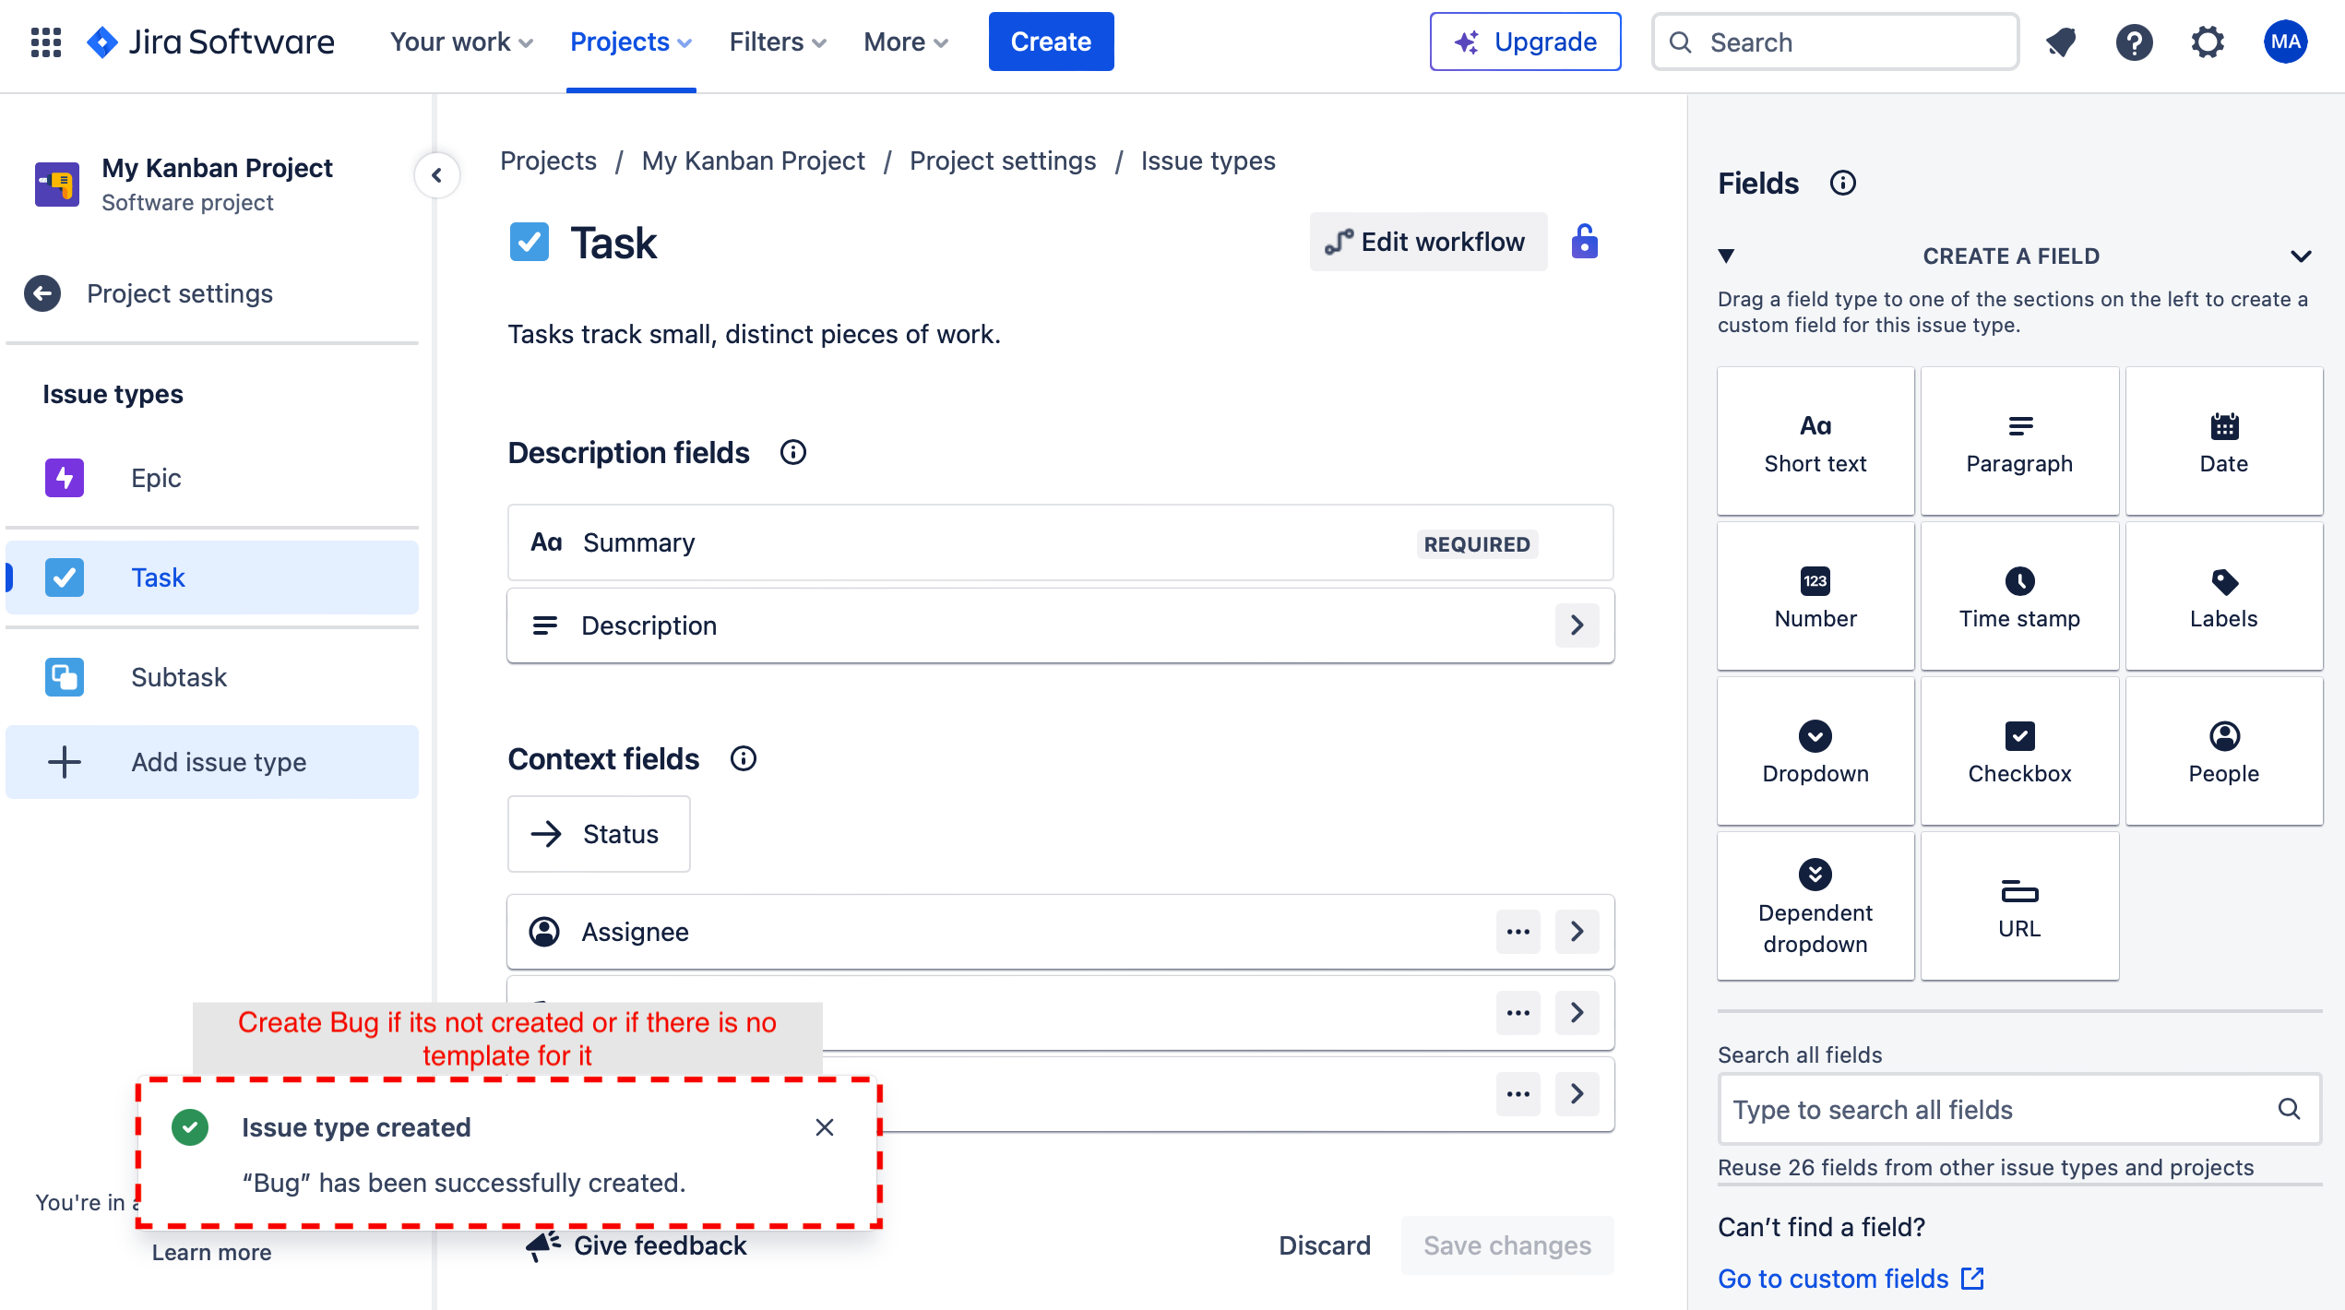
FIND THE BUG REPORT TEMPLATE CREATED BY YOUR LEAD TESTER

Slide 8
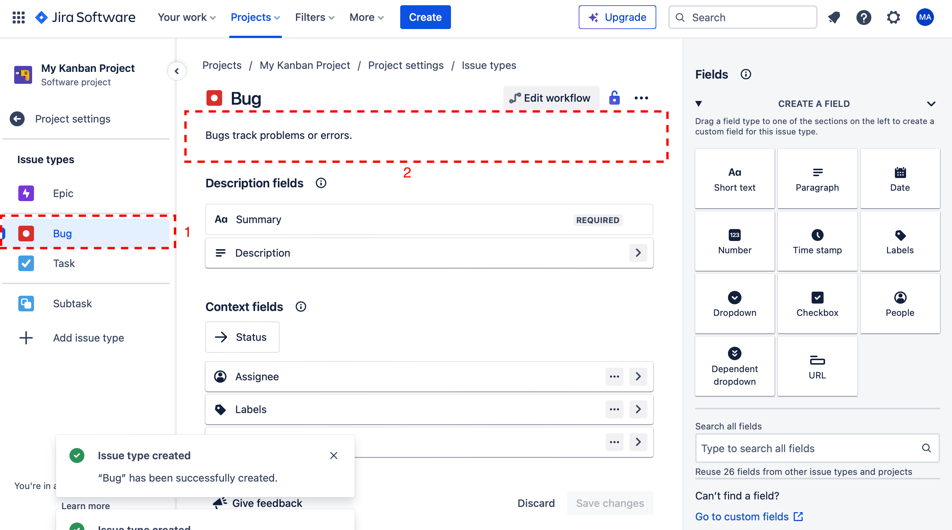
CREATE A NEW REPORT BASED ON THE TEMPLATE

Slide 9
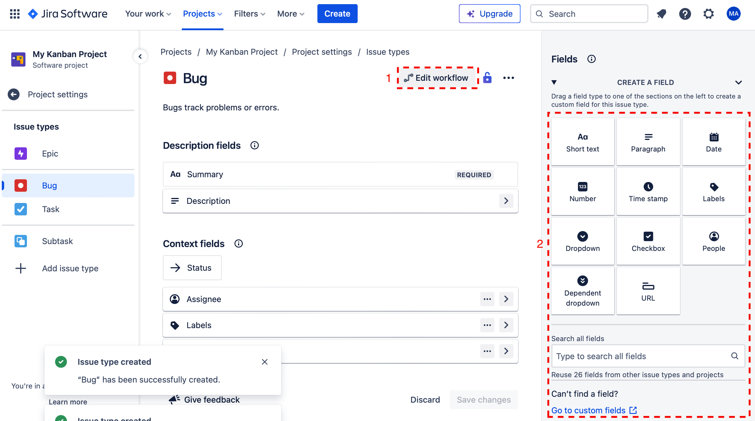
CREATE A NEW REPORT BASED ON THE TEMPLATE

Slide 10
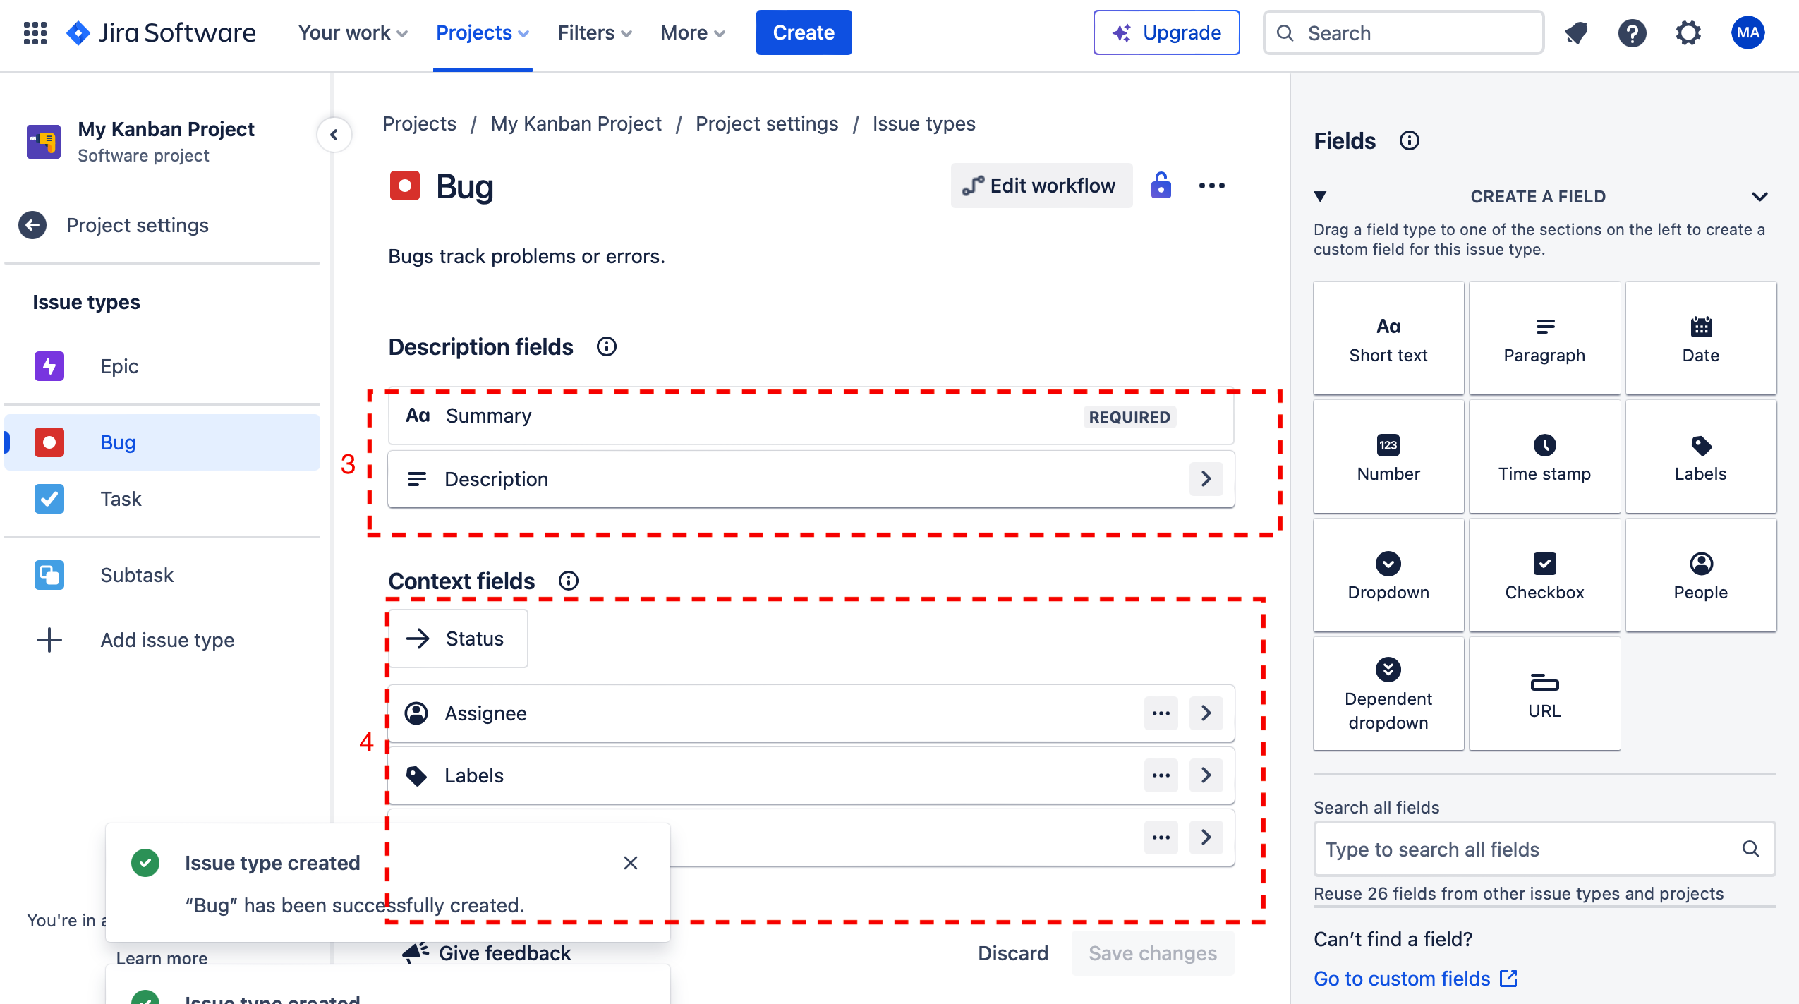
CREATE A NEW REPORT BASED ON THE TEMPLATE

Slide 11
4. ENSURE THE TOPIC OF THE REPORT CONTAINS THE FOLLOWING INFORMATION
- Project name
- Issue type
- Issue location
- Severity
- Runtime error code (if applicable)
- In the beginning of the topic put [TO VET] status

Slide 12
5. IN THE UPPER PARAGRAPH OF THE BUG REPORT MAKE A BRIEF EXPLANATION OF THE ISSUE
- Begin the bug report with a concise summary or explanation of the issue at hand. This summary should provide a high-level overview of the problem without going into too much detail.
- Include information such as the nature of the issue, its impact on the software or system, and any relevant context that helps the reader understand the significance of the problem.
- Keep this explanation brief but informative to provide a clear introduction to the bug.

Slide 13
6. FOLLOW BY MAKING AND ORDERING LIST OF THE STEPS TO REPRODUCE
After the introductory paragraph, create an ordered list outlining the steps necessary to reproduce the issue.
Start with the initial conditions or prerequisites required for reproducing the bug.
Then list each step, in sequential order, that leads to the manifestation of the issue.
Be precise and specific in describing each step to ensure accurate reproduction of the problem by the development team.

Slide 14
7. EXPLAIN WHY THE GIVEN ISSUE IS A PROBLEM
Following the steps to reproduce, provide an explanation of why the identified issue is problematic or undesirable.
Discuss the potential impact of the issue on users, functionality, performance, security, etc.
Highlight any potential risks or consequences associated with the unresolved issue to emphasize its significance to the development team.

Slide 15
8. DESCRIBE THE EXPECTED WAY THE SOFTWARE SHOULD OPERATE AFTER RESOLVING THE ISSUE
After explaining the problem, describe the expected behavior of the software once the issue has been resolved.
Clearly articulate the desired outcome or functionality that should be achieved post-resolution.
This description helps align the understanding of the expected fix and ensures that the development team knows what success looks like.

Slide 16
9. SUGGEST WAYS OF RESOLVING THE ISSUE
Optionally, provide suggestions or ideas for resolving the reported issue.
Offer insights, recommendations, or potential solutions based on your understanding of the problem and its underlying causes.
While optional, providing suggestions can sometimes expedite the resolution process by offering additional context or guidance to the development team.

Slide 17
10. ATTACH ANY ASSOCIATED FILES (DATA, TABLES, CRUSH REPORTS, SCREENSHOTS)
If there are any associated files that provide additional information or evidence related to the bug, attach them to the bug report.
This could include data tables, crash reports, screenshots illustrating the problem, or screen capture videos demonstrating the issue in action.
Attaching relevant files helps provide comprehensive context and aids in the investigation and resolution of the bug.

Slide 18
11. AFTER SUBMITTING THE REPORT, RE-ENTER IT BY CLICKING EDIT, AND SELECT THE SEVERITY IN ACCORDANCE WITH THE PROVIDED SEVERITY LIST ON SHAREPOINT

Slide 19
12. ASSIGN THIS REPORT TO YOUR TEAM LEAD, SO THIS REPORT COULD BE VETTED

Slide 20
13. COPY THE REPORT LINK AND BRIEF DESCRIPTION TO THE SEPERATE TRACKING LIST

Slide 21
NOTE: The team leads shall vet all the reports and reassign them to the development team lead with a [VETTED] status.
The development team lead distributes the reports to the developers for resolving, or, in case of lack or unclear information creates a new testing case for the testing team.
All the [RESOLVED] reports shall be regressed in order.
Testing is deemed as ongoing, until there are any tickets with no [CLOSED] status.

Slide 22
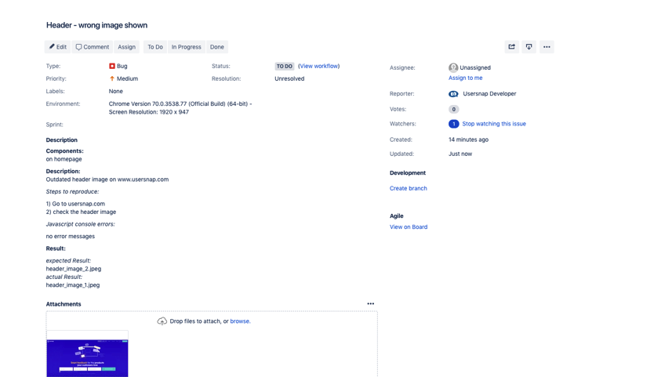
A SAMPLE BUG REPORT MADE WITH JIRA

